Slide 1

Object Oriented Programming
Fall 2020
Assignment 4
Seon Joo Kim
Yonsei University
<number>
Notes:
1

Slide 2
Outline
Deadline
No Plagiarism
Leave Comments
Scoring
Problem 1
Submission
Questions
Notes:
<number>

Slide 3
Deadline
Tuesday, December 1st 23:55
No late submissions at all

Slide 4
No Plagiarism
No Mercy.
The punishment will be made to both
the person who copied the code, and the person who shared the code.
We will do plagiarism test with codes that were made in previous semesters and also in google. So be careful ☺

Slide 5
Leave Comments
Leave comments in your file for TAs to understand your code.
If no comments in the file, there may be a reduction of points.

Slide 6
Scoring
Problem1 (100%)
If your code outputs correctly for given “main1.cpp”, “main2.cpp”
100% base score, 50% per each case
Scores will be given only by the final outputted file

Slide 7
Scoring
When ran the code, the printed text (by cout) in the terminal can be recorded in a file by ‘>>’ command
We will score the results by saving your programs printed texts by ‘>>’, and compare by ’diff’ command
problem1 will be graded in this way.
Compile Example
$ g++ -Wall -c class.cpp
$ g++ -Wall -c student.cpp
$ g++ -Wall -c main1.cpp $ g++ -Wall -c main2.cpp
$ g++ main1.o class.o student.o -Wall -o a.out $ g++ main2.o class.o student.o -Wall -o a.out
$ ./a.out >> output1.txt $ ./a.out >> output2.txt
$ diff answer1.txt output1.txt $ diff answer2.txt output2.txt

Slide 8
Problem 1
Write a class management system
It’s a simple program to manage classes
Implement two classes
For classes
For students

Slide 9
Problem 1
class Student
Should have member variables for
student name
ID
May have interface functions according to your design
decide names of functions by yourself
class Class
Should have member variables for
Class name
Instructor
Student list
A dynamic array to store students as needed

Slide 10
Problem 1
class Class
Should have interface functions
SetClassName
Parameter : name of class and name of professor
Set the name of class and the name of professor
Register
Parameter : student’s name and student’s ID
Create new student corresponding name and ID
Must use new operator
Withdraw
Parameter : student ID
Delete student from student list of the class
Must use delete operator
Display
Print information about the class
Name, instructor, total number and list of registered students

Slide 11
Requirements & Assumptions
Use dynamic memory allocation and deallocation for the list of students (pointer array)
The program must follow the ‘Gang of Three Rule’ (see lecture note Ch.10)
The Class class should have
Copy constructor
Member assignment operator
Destructor
All the Classes should follow the Data Hiding Principle
Use ‘Class Separation’ (see lecture note Ch. 11)
Separate header and code of each class.
Write include statements at proper place to avoid compilation error (Please try to compile your source code and run the executable before submission!!! Or you get zero score.)
Reasonable comments in English. (Important!)
Reasonable Indentation. (Important!)
Your program should work correctly in Linux Environment.

Slide 12
Problem 1
We use main function “main1.cpp”, “main2.cpp” to test two class
See the code of main function provided in next page
Write each class in separate source code file
Create header file and cpp file for each class
for Class class
class.hpp
class.cpp
for Student class
student.hpp
student.cpp
cf) “main1.cpp”, “main2.cpp” for main function

Slide 13
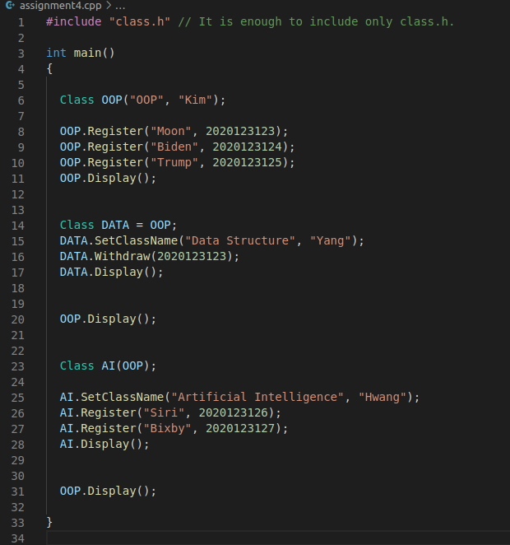
“main1.cpp”
(1) First, Make a class OOP with a class name and a professor name
(2) Register 3 students and display all students in the OOP class
(3) Make a class ‘Data structure’ from a OOP class using ‘operater =‘
and change a class name and a professor name
(4) Withdraw student ‘Moon’ using student number
and display it
‘copy constructor’
(5) Make a class ‘Artificial Intelligence’ from a OOP class using ‘copy constructor’
(6) Register student ‘Siri’, ‘Bixby’ and display it

Slide 14
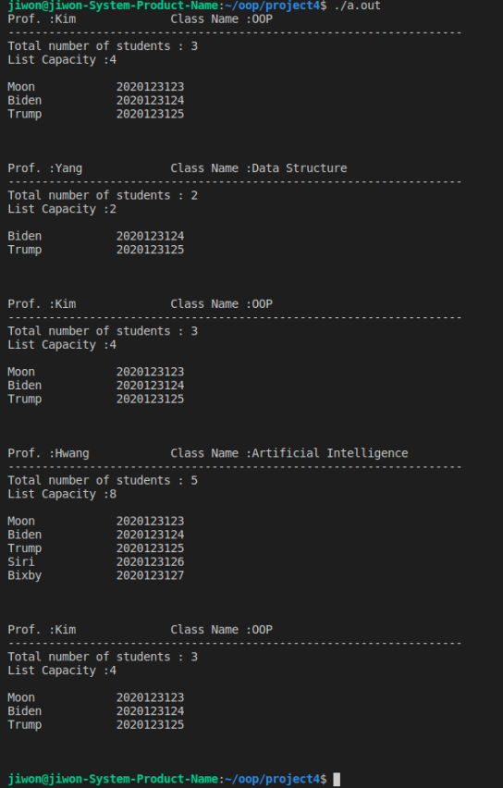
Result output of the program
“main1.cpp”
(1) Withdraw student ‘Moon’ in Data Structure using student number and display it
(2) Students member in OOP are not changed by withdrawal in Data Structure.
(3) Register student ‘Siri’, ‘Bixby’ in Artificial Intelligence and display it
(4) Students member in OOP are not changed by registration in Artificial Intelligence.

Slide 15
Result output of the program
“main1.cpp”
required | empty
requiredNum : 3 / capacity : 4
requiredNum : 2 / capacity : 2
requiredNum : 3 / capacity : 4
requiredNum : 5 / capacity : 8
requiredNum : 3 / capacity : 4

Slide 16
“main1.cpp”

Slide 17
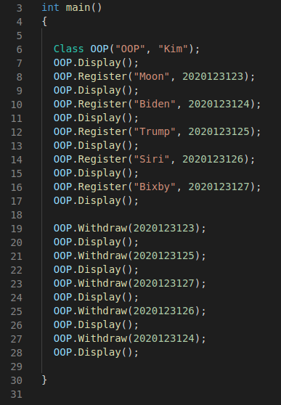
“main2.cpp”
for dynamic array

Slide 18
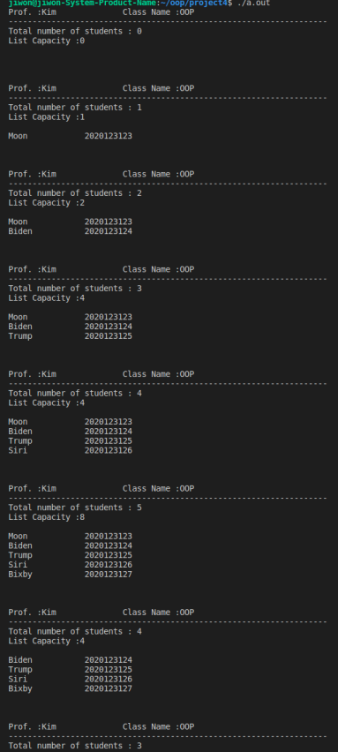
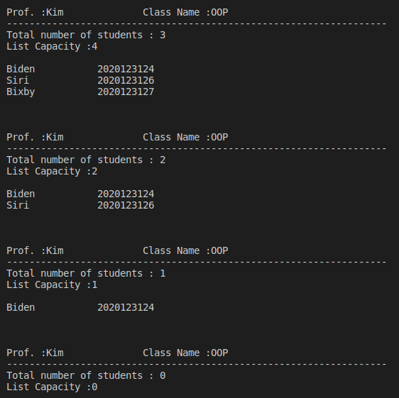
required | empty
Result output of the program
“main2.cpp”
empty
empty

Slide 19
Submission
Zip the folder by following steps correctly
studentId_hw4.tar.gz
Ex) 2020123456_hw4.tar.gz
There is going to be reduction of points if not following the folder hierarchy as well
If unzipped your submission .tar.gz file should follow the folder hierarchy below
Current directory
- studentId_hw4.tar.gz
- studentId_hw4
- main1.cpp, - main2.cpp
- class.cpp, - class.hpp
- student.cpp, - student.hpp (total 6 files)

Slide 20
Questions
Use oop20202@gmail.com for questions
We are not going to answer
Questions sent to TAs’ personal mails
Questions not making sense
Questions related to the algorithm for solving the question
Questions you can infer the answer if read this file thoroughly
Questions you can simply solve by googling
Ex) how do I make a folder on ubuntu?

Slide 21
Appendix
File I/O
#include <fstream>
ofstream outfile;
outfile << "Hello, World!\n"; // writing Hello,World! into the file
outfile.close(); // should close the file before terminating the process
ifstream infile("input.txt");
infile >> number; // reading the first digit written in input.txt
infile.close(); // should close the file before terminating the process
https://stackoverflow.com/questions/7868936/read-file-line-by-line-using-ifstream-in-c

Slide 22
Appendix
Zipping and unzipping the folder by tar command
https://linuxize.com/post/how-to-extract-unzip-tar-gz-file/
https://www.cyberciti.biz/faq/how-do-i-compress-a-whole-linux-or-unix-directory/

